Slide 1
RAJALAKSHMI ENGINEERING COLLEGE
FACULTY 4.0
FDP ON PYTHON PROGRAMMING
MODULE 1
DAY 08

Slide 2
CONTENTS
Tuple-Data Structure
Tuple Creation
Tuple Indexing
Tuple Operators
Tuple Functions
Tuple Methods
Problem Solving

Slide 3

Tuple-( )
Eg :(1,2,3.14,”hello”)
Tuple is a data structure(collection) in python which is used to store the sequence of element of various types.
( ) is used to represent the tuple data structure
Tuple are immutable-means the elements in the tuple
cannot be modified.
The items in the tuple are separated with the comma (,).
Elements of the tule can be accessed by their index.
Elements can be homogeneous or heterogeneous but they are READ-ONLY.
List are mutable
Tuple are immutable

Slide 4
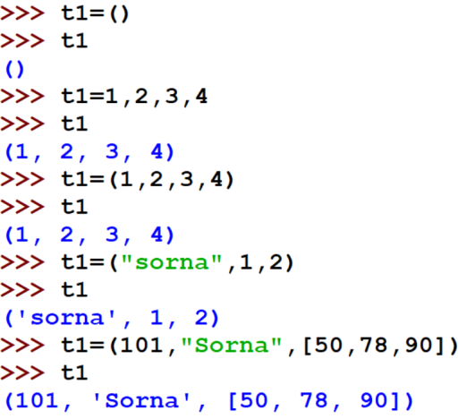
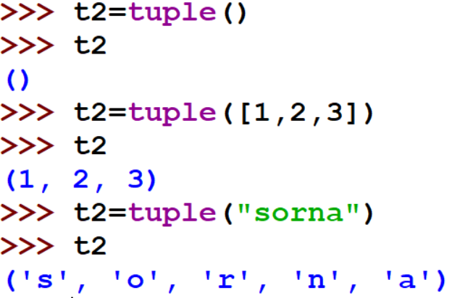
Tuple Creation
Tuple is created by placing all the elements within round brackets , separated by commas.
Method -1
Method -2

Slide 5
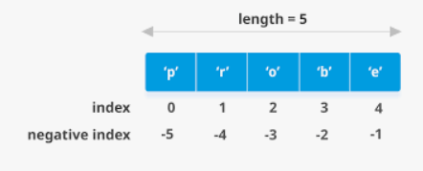
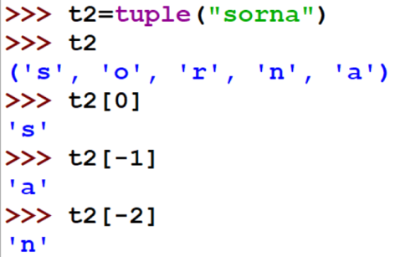
Tuple Indexing
Tuple elements are indexed starting from 0.
Tuple supports negative indexing starting from the list element indexed as -1.
Tuple elements can be accessed through their index.
Example
OUTPUT

Slide 6
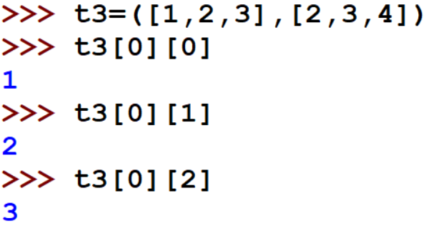
Nested Tuple Indexing
Example
OUTPUT

Slide 7

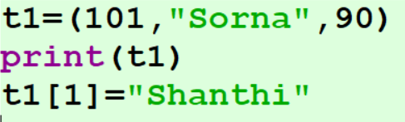
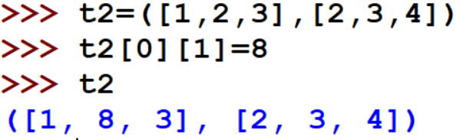
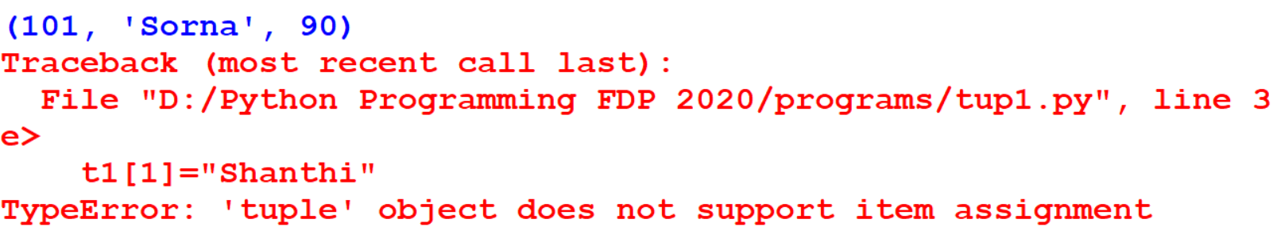
Tuple are Immutable
Since tuple are immutable , elements cannot be modified
Example
OUTPUT
Mutable elements of a tuple can be modified

Slide 8
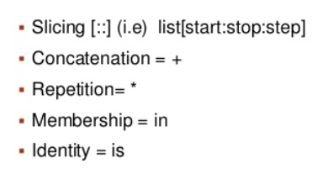
Tuple Operators

Slide 9
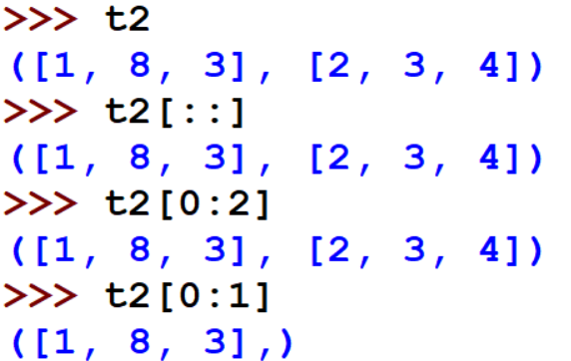
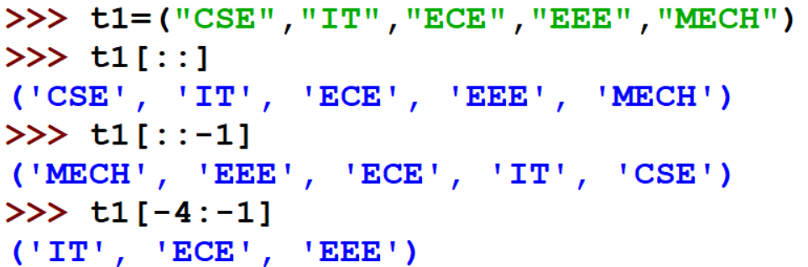
Tuple Slicing
To access a range of elements from the Tuple ,we can go for Tuple slicing
Slicing operator[::] , that is list[start : end : step]
Example
OUTPUT

Slide 10
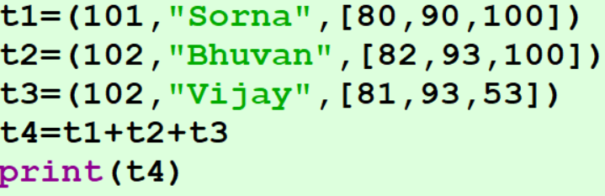
Tuple Concatenation (+)
To concatenate two Tuple we can use + operator
Example
OUTPUT

Slide 11
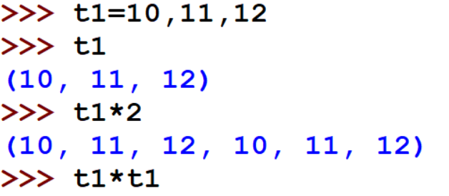
Tuple Repetition (*)
Enables the Tuple elements to be repeated multiple times
Example
OUTPUT

Slide 12
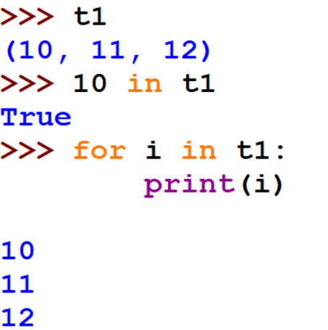
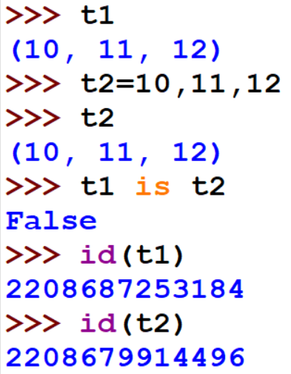
Tuple –in and is operators
Example
OUTPUT

Slide 13
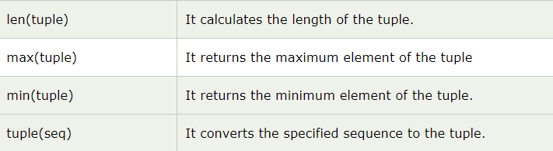
Tuple :Built-in functions

Slide 14
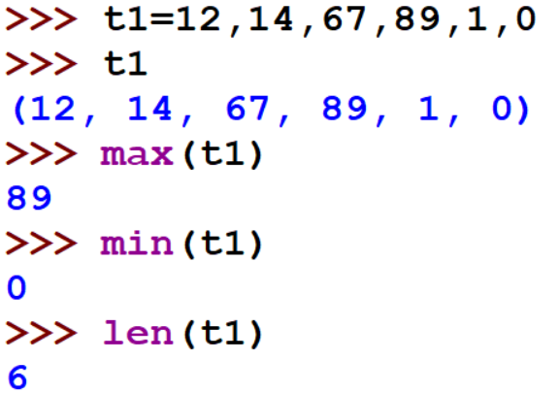
Tuple :Built-in functions

Slide 15
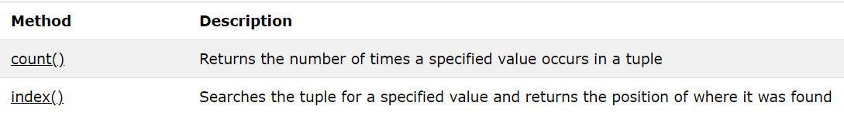
Tuple :Built-in Methods
Since tuple are immutable adding and deleting elements is not possible

Slide 16
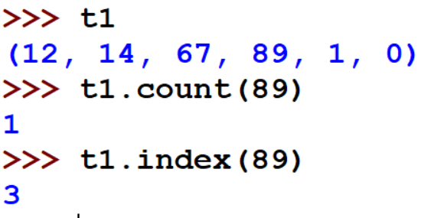
Count and Index Methods
count()
index()

Slide 17


Where to use tuple?
If a sequence need to be a read only sequence then tuple can be used to represent it
Can be used to simulate a dictionary without keys
[(101, “Sorna", 22), (102, “Priya", 28), (103, “Nesa", 30)]

Slide 18
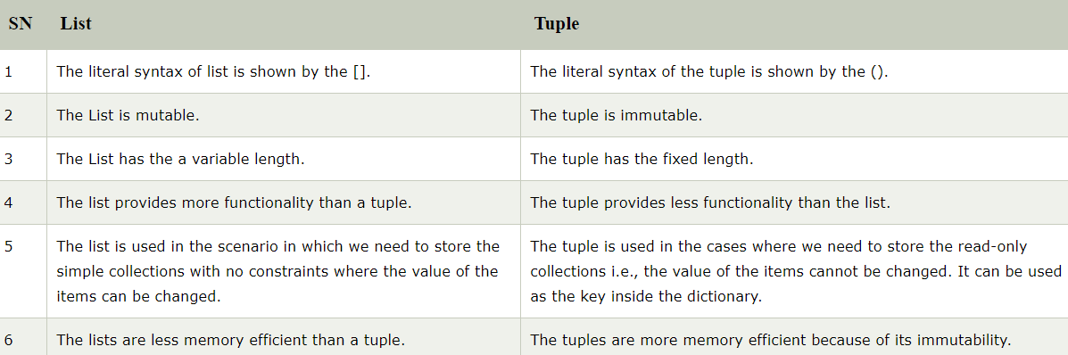
List vs Tuple

Slide 19

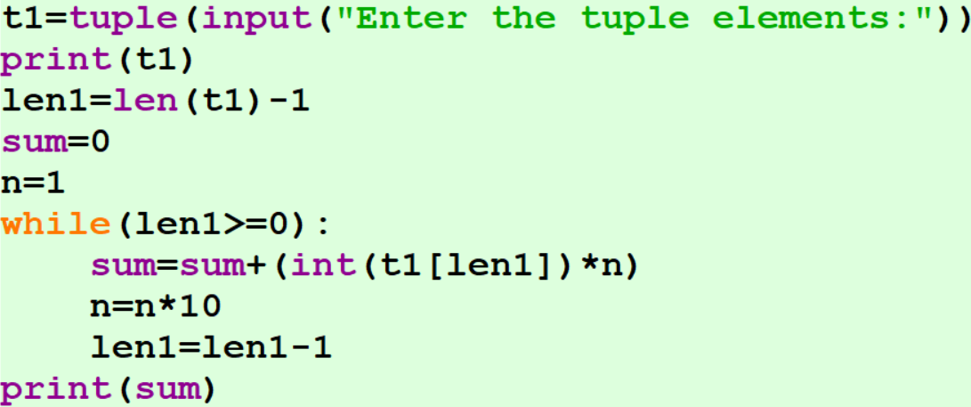
Write a Python program to convert a given tuple of positive integers into an integer.
Example 1
Input:
A tuple
(1,2,3,4,5)
Output:
12345

Slide 20
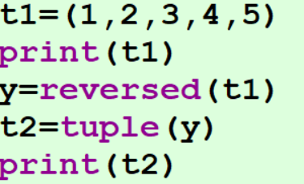
Write a Python program to reverse a tuple and print the result
Sample Input
(1,2,3,4,5)
Expected Result : (5,4,3,2,1)
Example 2
Logic:
A tuple cannot be reversed
But we can apply reversed() function over it and create a new tuple which contains the reversed data
Input:
A tuple
(1,2,3,4,5)
Output:
(5,4,3,2,1)

Slide 21
Write a Python program to print a tuple with string formatting
Example 3
Input:
A tuple
(100, 200, 300)
Output:
(100, 200, 300)
Program:
t = (100, 200, 300)
print('This is a tuple {0}'.format(t))
Output:
t is a tuple (100, 200, 300)
Logic:
Use format function

Slide 22
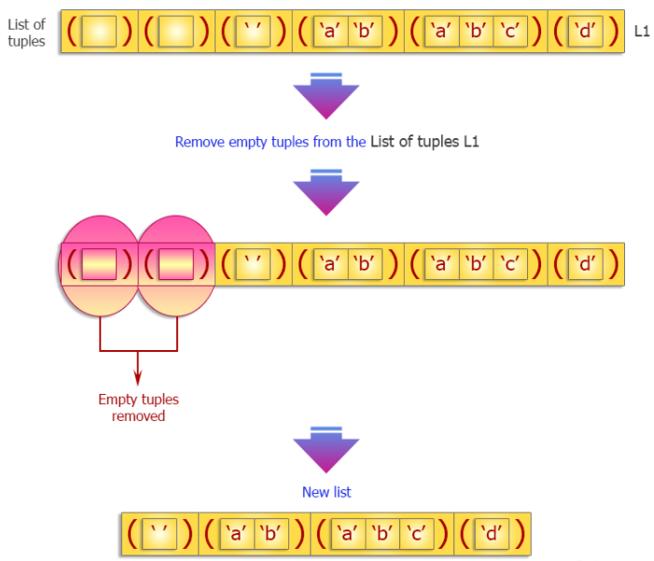
Write a Python program to remove an empty tuple(s) from a list of tuples.
Example 4
Program:
L = [(), (), ('',), ('a', 'b'), ('a', 'b', 'c'), ('d’)]
L = [t for t in L if t]
print(L)
Output:
[('',), ('a', 'b'), ('a', 'b', 'c'), 'd']

Slide 23
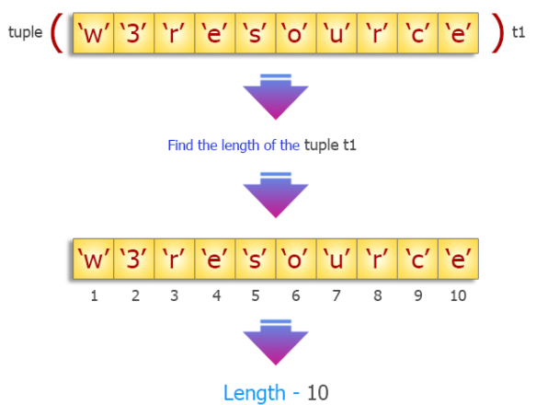
Write a Python program to find the length of a tuple.
Example 5
Program:
tuplex = tuple("w3resource")
print(tuplex)
print(len(tuplex))
Output:
('w', '3', 'r', 'e', 's', 'o', 'u', 'r', 'c', 'e’)
10

Slide 24


